Slide 1
Regular Expression
A regular expression (RE) is a string that represents a pattern.
With RE functionality, you can check any string with the pattern and see if any part of the string matches the pattern.
The re module supplies Python’s RE functionality.
Since RE patterns often contain backslashes, you often specify them using raw string syntax

Slide 2
Regular expressions use two types of characters:
a) Meta characters: have a special meaning
Ex. . ^ $ * + ? { } [ ] \ | ( )
b) Literals: have usual meaning
Ex. A, B, a, b, text, 0,1, 9

Slide 3
Uses of regular expressions:
Search a string (search and match)
Finding a string (findall)
Break string into a sub strings (split)
Replace part of a string (sub)

Slide 4
Various methods of Regular Expressions
The ‘re’ package provides multiple methods to perform queries on an input string.
re.match()
re.search()
re.findall()
re.split()
re.sub()
re.compile()

Slide 5
re.match(pattern, string, flag=0)
This function attempts to match RE pattern to string with optional flags.
The match() method will only find matches if they occur at the start of the string being searched.

Slide 6
Pattern the regular expression to be matched.
String the string, which would be searched to match the pattern at the beginning of string.
Flags You can specify different flags using bitwise OR (|). These are modifiers.

Slide 7
The re.match function returns
a match object on success,
none on failure.

Slide 8
We use group(num) or groups() function of match object to get matched expression.
Match Object Methods Description
group(num=0) This method returns entire match (or specific subgroup num)
groups() This method returns all matching subgroups in a tuple (empty if there weren't any)

Slide 9
import re
pattern=“dog”
string=“dog vs cat”
result=re.match(pattern, string)
print(result) #<_sre.SRE_Match object; span=(0, 3), match='dog'>
print(result.group(0)) #dog

Slide 10
re.search(pattern, string, flag=0)
This function searches for first occurrence of RE pattern within string with optional flags.
The re.search() function returns
a match object on success,
none on failure.

Slide 11
import re
result=re.search("CA", "BCOM BCA MCOM BTech")
print(result.group(0)) #CA

Slide 12
Matching Versus Searching
Python offers two different primitive operations based on regular expressions:
match() checks for a match only at the beginning of the string.
search() checks for a match anywhere in the string.

Slide 13
re.findall (pattern, string)
It returns
a list of all matching patterns on success.
a blank list on failure
It has no constraints of searching from start or end.
NOTE: Do not use group()/groups() with findall() returned object as it is a list.

Slide 14
import re
result=re.findall("CA", "BCOM BCA MCA BTech CA")
print(result) #['CA', 'CA', 'CA']

Slide 15
re.split(pattern, string, [maxsplit=0])
split a string by the occurrences of given pattern.
returning a list containing the resulting substrings.
If the pattern is not found, string is returned unchanged
import re
result=re.split("CA", "BCOM BCA MCA BTech BA")
print(result) # ['BCOM B', ' M', ' BTech BA']

Slide 16
import re
result=re.split("CA", "BCOM BCA MCA BTech BA", maxsplit=1)
print(result) # ['BCOM B', ' MCA BTech BA']

Slide 17
re.sub(pattern, repl, string)
search a pattern and replace with a new sub string.
If the pattern is not found, string is returned unchanged
import re
result=re.sub("CA","ca", "BCOM BCA MCA BTech BA")
print(result) #BCOM Bca Mca BTech BA

Slide 18
re.compile(pattern, flag=0)
We can combine a regular expression pattern into pattern objects, which can be used for pattern matching.
It also helps to search a pattern again without rewriting it.

Slide 19
import re
p=re.compile("CA")
r1= p.findall("BCOM BCA MCA BTech BA")
r2=p.split("BCOM BCA MCA BTech BA")
r3=p.sub("ca","BCOM BCA MCA BTech BA")
print(r1) #['CA', 'CA']
print(r2) #['BCOM B', ' M', ' BTech BA']
print(r3) #BCOM Bca Mca BTech BA

Slide 20
Python Bitwise Operators
Bitwise operator works on bits and performs bit by bit operation.
Assume if a = 60; and b = 13;
Now in binary format they will be as follows:
a = 0011 1100
b = 0000 1101
-----------------
a&b = 0000 1100
a|b = 0011 1101
a^b = 0011 0001
~a = 1100 0011

Slide 21
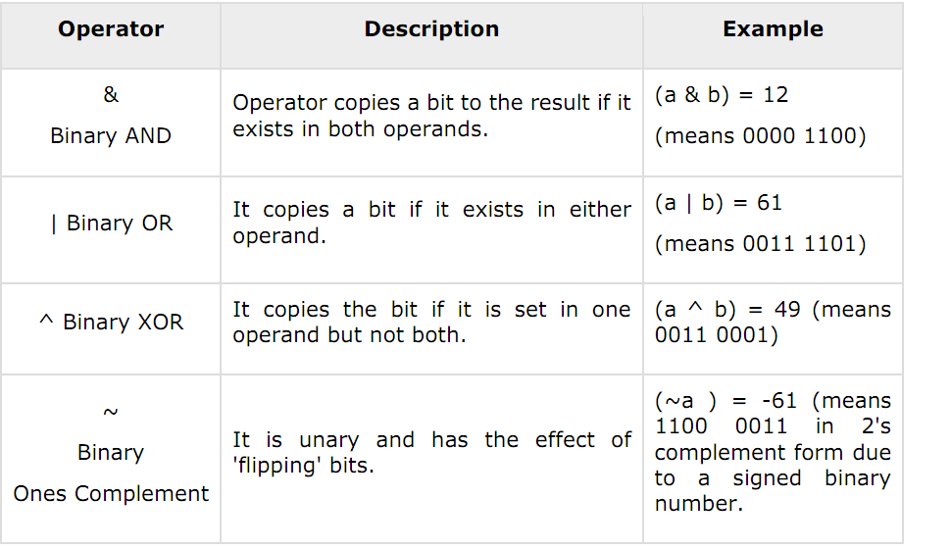

Slide 22
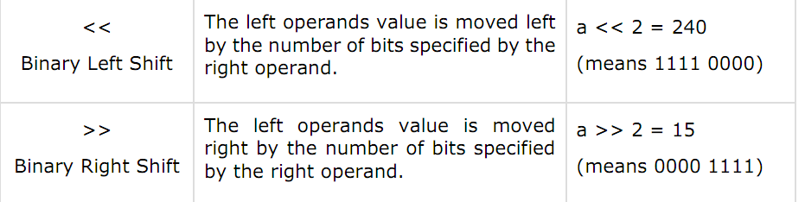

Slide 23
WHY WE NEED RE ?
Problem: extract the area code from the given string, area code is of three digit.
phone_number ="Home: (555) 265-2901“
phone_number = "Cell (mobile): (555)-918-8271“

Slide 24
solution without regular expression
phone_number="Home: (555) 265-2901“
start = phone_number.find( '(‘ )
print(start)
6
start=start+1
end=start+3
area_code=phone_number[start : end]
print(area_code)
555

Slide 25
phone_number = "Cell (mobile): (555)-918-8271“
Previous code can’t work here
Ans is mob

Slide 26
solution with regular expression
import re
phone_number="Home: (555) 265-2901“
result=re.search("\((\d{3})\)", phone_number)
area_code=result.group(1)
print(area_code)
555

Slide 27
phone_number="Cell (mobile): (555) 265-2901“ result=re.search("\(\d{3}\)", phone_number) area_code=result.group(0) print(area_code) (555)
import re
phone_number="Cell (mobile): (555) 265-2901“
result=re.search("\((\d{3})\)", phone_number)
area_code=result.group(1)
print(area_code)
555
OR

Slide 28
The following special-character sequences are recognized in regular expression patterns:
Character Description
text Matches the literal string text.
. Matches any character except newline.
^ Matches the start of a string.
$ Matches the end of a string.
* Matches zero or more repetitions of the preceding expression, matching as many repetitions as possible.
+ Matches one or more repetitions of the preceding expression, matching as many repetitions as possible.

Slide 29
? Matches zero repetitions or one repetition of the preceding expression.
*? Matches zero or more repetitions of the preceding expression, matching as few repetitions as possible.(NON GREEDY)
{m} Matches exactly m repetitions of the preceding expression.
{m, n} Matches from m to n repetitions of the preceding expression, matching as many repetitions as possible. If m is omitted, it defaults to 0. If n is omitted, it defaults to infinity.

Slide 30
[...] Matches a set of characters such as r'[abcdef]' or r'[a-zA-z]'. Special characters such as * are not active inside a set.
[^...] Matches the characters not in the set, such as r'[^0-9]'.
A|B Matches either A or B, where A and B are both regular expressions.

Slide 31
(...) Matches the regular expression inside the parentheses as a group and saves the matched substring.
The contents of a group can be obtained using the group() method of MatchObject objects obtained while matching.
12. (.*) Matches any character (.) repeated zero or more times (*).
Here parentheses tells Python to save away the part of the string matched by that part of the pattern as a group—a matched substring available after the match.

Slide 32
* Vs *? Greedy Vs Non Greedy
>>> a=re.findall("1.*1","10010000001")
>>> a
['10010000001']
>>> a=re.findall("1.*?1","10010000001")
>>> a
['1001']

Slide 33
Special Sequences
The special sequences consist of "\\" and a character from the following list:
\d Matches any decimal digit; equivalent to the set [0-9].
\D The complement of \d. It matches any non-digit character; equivalent to the set [^0-9].
\s Matches any whitespace character; equivalent to [ \t\n\r\f\v].
\S The complement of \s. It matches any non-whitespace character; equiv. to [^ \t\n\r\f\v].

Slide 34
\w Matches any alphanumeric character; equivalent to [a- zA-Z0-9_].
\W Matches the complement of \w.
\b Matches the empty string, but only at the start or end of a word.
\B Matches the empty string, but not at the start or end of a word.
\\ Matches a literal backslash.

Slide 35
Compilation flags
Compilation flags let you modify some aspects of how regular expressions work.
Flags are available in the re module under two names,
a long name such as IGNORECASE and
a short, one-letter form such as I.
Flag Meaning
DOTALL, S Make, match any character, including newlines
IGNORECASE, I Do case-insensitive matches
MULTILINE, M Multi-line matching, affecting ^ and $

Slide 36
Some Examples
a=re.findall(".a","\na dabc abd abs sbabb",re.DOTALL)
a
['\na', 'da', ' a', ' a', 'ba']

Slide 37
Questions
Text= "Guido will be out of the office from 12/15/2012 - 1/3/2013.“
Extract the both dates from the given text.

Slide 38
a=re.findall("\d{1,2}/\d{1,2}/\d{4}",text)

Slide 39
PROBLEMS
Problem 1: Return the first word of a given string
Problem 2: Return the first two character of each word
Problem 3: Return the domain type of given email-ids
Problem 4: Return date from given string
Problem 5: Return all words of a string those starts with vowel
Problem 6: Validate a phone number (phone number must be of 10 digits and starts with 8 or 9)

Slide 40
Solution 1
>>> a=re.match("\w+", "hello how are you?")
>>> a.group()
'hello'

Slide 41
Solution 2
>>> a=re.findall(r"\b\w\w", "hello how are you?")
>>> a
['he', 'ho', 'ar', 'yo']

Slide 42
Solution 3
>>> a=re.findall(r"@\w+", "abc.test@gmail.com, xyz@test.in, test.first@analyticsvidhya.com, first.test@rest.biz")
>>> a
['@gmail', '@test', '@analyticsvidhya', '@rest']

Slide 43
Solution: To extract the domain type only
import re
a=re.search("@(\w+).(\w+)", "abc.test@gmail.com")
print(a.group()) #@gmail.com
print(a.group(0)) #@gmail.com
print(a.group(1)) # gmail
print(a.group(2)) #com
print(a.groups()) #('gmail', 'com')

Slide 44
Solution 4
>>>a=re.findall(r"\d{2}/\d{2}/\d{4}", "today is 11/14/2018")
>>>a
['11/14/2018']

Slide 45
Solution – 2 Extract only domain name using “( )”
Code
result=re.findall(r'@\w+.(\w+)','abc.test@gmail.com, xyz@test.in, test.first@analyticsvidhya.com, first.test@rest.biz')
print (result)
Output: ['com', 'in', 'com', 'biz']

Slide 46
Problem 4: Return date from given string
Here we will use “\d” to extract digit.
Solution:
Code
result=re.findall(r'\d{2}-\d{2}-\d{4}','Amit 34-3456 12-05-2007, XYZ 56-4532 11-11-2011, ABC 67-8945 12-01-2009')
print (result)
Output: ['12-05-2007', '11-11-2011', '12-01-2009']
If you want to extract only year again parenthesis “( )” will help you.

Slide 47
result=re.findall(r'\d{2}-\d{2}-(\d{4})','Amit 34-3456 12-05-2007, XYZ 56-4532 11-11-2011, ABC 67-8945 12-01-2009')
print (result)
Output: ['2007', '2011', '2009']

Slide 48
Problem 5: Return all words of a string those starts with vowel
Solution-1 Return each words
Code
result=re.findall(r'\b[aeiouAEIOU]\w+','AV is largest Analytics community of India')
print (result)
Output: ['AV', 'is', 'Analytics', 'of', 'India']

